Slide 1
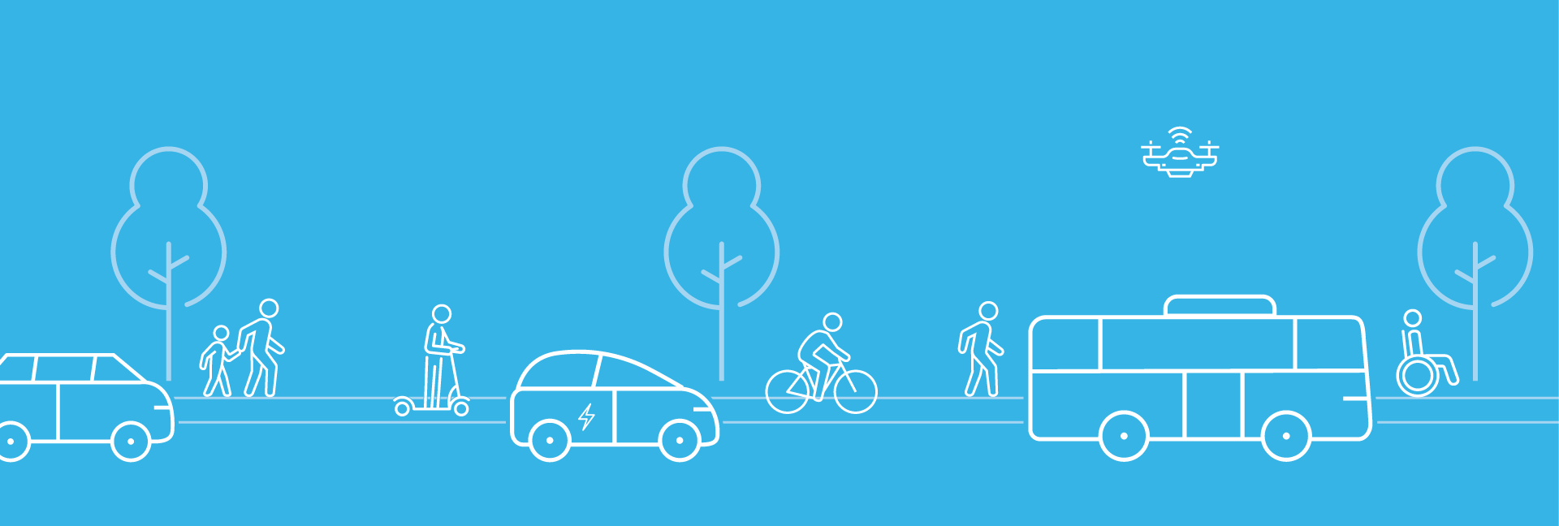
Caltrans Office of Race and Equity
CORE

Slide 2
California Transportation Agency Statement June 2020
“Transportation systems are about people and improving their quality of life. Unfortunately, those improvements historically have disproportionately benefitted certain segments of the population. Far too often, past transportation decisions quite literally put up barriers, divided communities, and amplified racial inequalities, particularly in our Black and Brown neighborhoods.
“The California State Transportation Agency (CalSTA) strongly condemns systemic racism and discrimination in all forms, including those historically entrenched in transportation. Enhancing the lives of all Californians – particularly people of color and disadvantaged communities – by connecting individuals to jobs, healthcare, education and other opportunities lie at the heart of what we do and why.
Notes:
Context-
Our government leaders are recognizing and making a commitment to change.

Slide 3
California Transportation Agency Statement June 2020
“To that end, CalSTA firmly embraces racial equity, inclusion and diversity. These values are foundational to achieving our vision of a cleaner, safer, more accessible and more connected future.
“We will be part of the solution. We will promote policies and programs that reflect principles of diversity, equity and inclusion, and will work with stakeholders to identify areas of improvement. Through these and other efforts, transportation systems have the potential to achieve their intended purpose – to provide safe and equitable access to opportunity and truly enhance quality of life.”

Slide 4
Caltrans Equity Statement
Caltrans acknowledges that communities of color and under-served communities experienced fewer benefits and a greater share of negative impacts associated with our state’s transportation system. Some of these disparities reflect a history of transportation decision-making, policy, processes, planning, design, and construction that "quite literally put-up barriers, divided communities, and amplified racial inequities, particularly in our Black and Brown neighborhoods."….
We will achieve equity when everyone has access to what they need to thrive — starting with our most vulnerable — no matter their race, socioeconomic status, identity, where they live, or how they travel...
Notes:
Equity Statement- one of the first for a State DOT. Especially calling out our ownership in harm to specific communities. Caltrans acknowledges that communities of color and under-served communities experienced fewer benefits and a greater share of negative impacts associated with our state’s transportation system. Some of these disparities reflect a history of transportation decision-making, policy, processes, planning, design, and construction that "quite literally put-up barriers, divided communities, and amplified racial inequities, particularly in our Black and Brown neighborhoods."….
Caltrans recognizes our leadership role and unique responsibility in State government to eliminate barriers to provide more equitable transportation for all Californians. This understanding is the foundation for intentional decision-making that recognizes past, stops current, and prevents future harms from our actions.
Where many Equity Goals and Actions are being carried out across the department
The focus includes the effects of transportation development on tribal cultural sites, places, landscapes, and areas of tribal stewardship concerns;
Recently released our 2nd REAP, calling it a Living Document- highlight where we started, what we have accomplished, and where we are going.

Slide 5
Caltrans Equity Statement
Areas of focus:
People
We will strive for a workforce at all levels that reflects the communities we serve by improving recruitment, hiring, contracting, & leadership development
Programs & Projects
We will meaningfully engage communities by creating a transparent, inclusive, and ongoing process. Prioritize projects that improve access
Notes:
Caltrans Equity Statement
We will meaningfully engage communities most impacted by structural racism in the creation and implementation of the programs and projects that impact their daily lives by creating more transparent, inclusive, and ongoing consultation and collaboration processes. We will achieve our equity commitments through an engagement process where everyone is treated with dignity and justice. We will reform our programs, policies, and procedures based on this engagement to avoid harm to frontline and vulnerable communities. We will prioritize projects that improve access for and provide meaningful benefits to underserved communities.

Slide 6
Caltrans Equity Statement
Areas of focus:
Planet
We commit to combatting the climate crisis and its disproportionate impact on frontline and vulnerable communities for current and future generations
Partnerships
Leveraging our investments, we commit to increasing pathways to opportunity for minority-owned & disadvantaged business enterprises
Notes:
We commit to combatting the climate crisis and its disproportionate impact on frontline and vulnerable communities — such as Black and Indigenous peoples, communities of color, the people experiencing homelessness, people with disabilities, and youth. We will change how we plan, design, build, and maintain our transportation investments to create a more resilient system that more equitably distributes the benefits and burdens to the current and future generations of Californians.

Slide 7
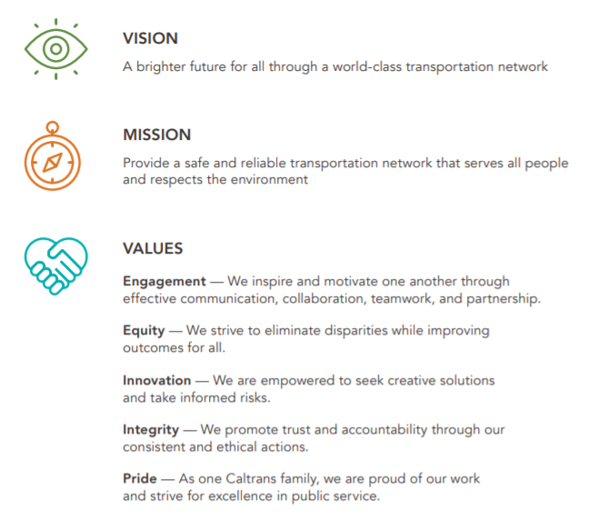
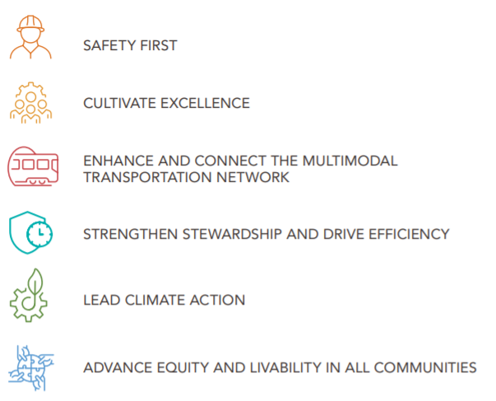
CT Strategic Plan 2020-24
3
Notes:
From our data, without taking conscious steps towards inclusion and equity within our diversity (internal and external), we risk the creating disparities and the replication of historical inequity. SO
"Equity is taking a front-and-center role within Caltrans mission/vision/principles, so it relates to all of us“ And we are really trying to minimize and eliminate disparities from and within our transportation system. Equity is elevated to a value and goal.

Slide 8
SP 2020-24
Notes:
In advancing Equity and Livability in all communities we are setting the stage for increased engagement to have an understanding of the needs of our communities so that we all thrive.

Slide 9
SP 2020-24
Notes:
In advancing Equity and Livability in all communities we are setting the stage for increased engagement to have an understanding of the needs of our communities so that we all thrive.
Engagement
Project
Prioritization
Funding

Slide 10
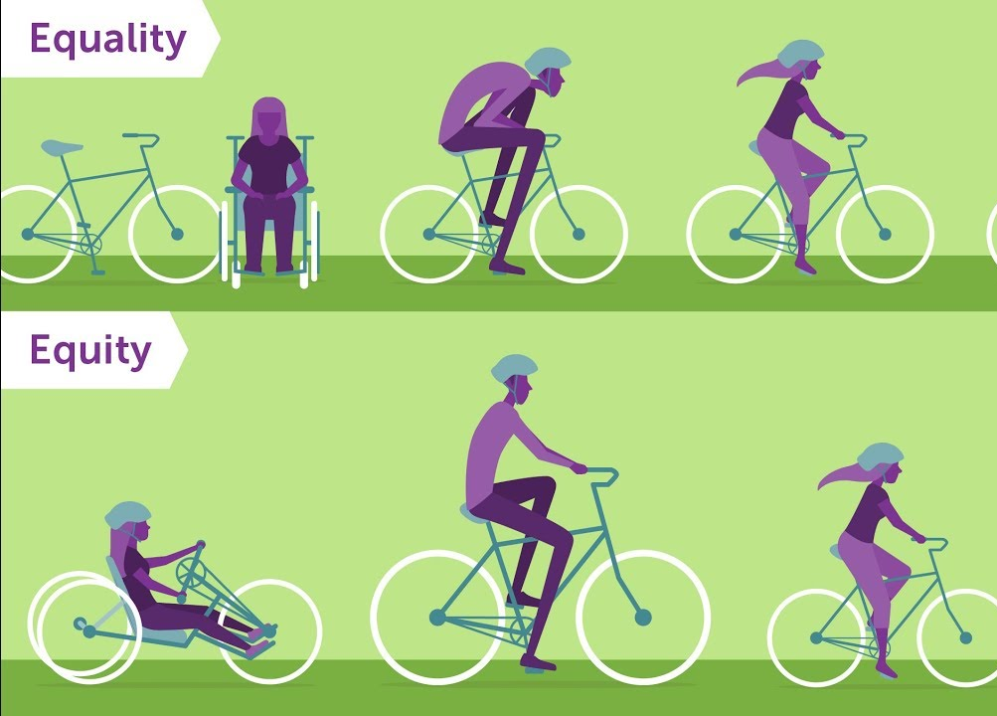
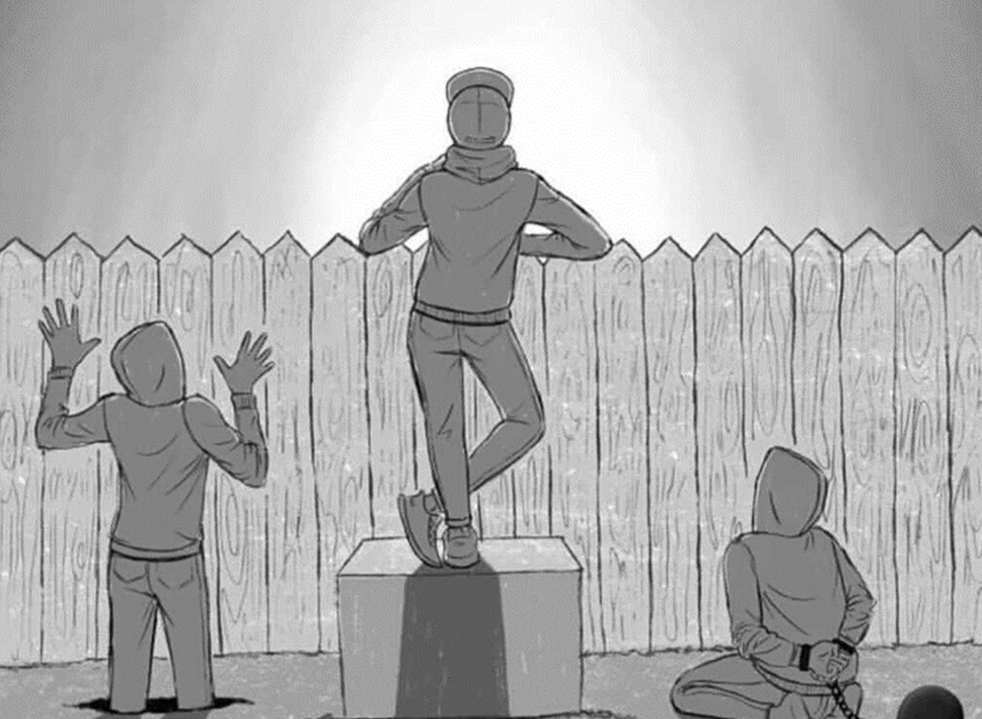
Equity vs. Equality
Equality = Same treatment for all
Equal treatment does not necessarily create equal outcomes
Equity = Treatment that accounts for disparities
To ensure that everyone can succeed, we need to tailor our services to different groups’ needs
Notes:
This image gives us a quick visualization of equality vs equity. We see in the equality visualizing that everyone has the same size and type of bike. This is representative of equal treatment for all but it doesn’t always create equal outcomes.
The bottom image portrays different sizes and types of bikes that people could use and it tells us it visually represents the change that suits their needs. Equity is ensuring that everyone can succeed when we are able to change our services to meet the needs of different people and groups. Treatments that account for disparities.
Last fall, I saw a different graphic of equity that really resonated.
It is different from the familiar equity graphics many of us have used to explain equity visually or are used to seeing… similar to that of the last slide where there are “individuals of different sizes (smaller or childlike) one the or bikes or the three individuals trying to watch a ball game.”
This image here by Nicolas Barcelo & Sonya Shadravan (illustrated Aria Ghalili) Portrays three individuals of equal size/stature, experiencing external forces that distort how tall they appear.
And I wanted to show this image because it reveals many biased foundational beliefs about innate differences in value or merit that often challenge our equity-based efforts.
Jeanie, Shalinee, David, and myself make up the core DEI leads- And many of you are championing DEI in your districts and offices.
This DEI team has worked tirelessly to build off the executive and staff level DEI commitments that started three years ago.
We took on new leadership roles to build, rebuild and reimagine our offices so that we are now in strategic positions to meaningfully coordinate, collaborate and holistically lead Caltrans DEI efforts.

Slide 11
Towards Equity
Equity 101
History & Heritage Celebration
Tool Kit
Notes:
A lot of unlearning and learning taking place- We have to make sure staff understand equity, diversity and inclusion.
Make sure staff have the tools to make the necessary changes towards equity.
Going beyond the statements:
Centering DEI in our training platforms
Equity 101 consultations
Program to program
Office to Office
Spring 2021 Glossary of Terms released and added to the living DEI tool kit
Expanded Diversity and Heritage Month Celebrations
Equity and Justice Centered discussion and content
Highlighting internal and external leaders
Equitable Engagement Training Platform (DOTP)
Pilot Effort
Cohort 1
Next is Train the Trainer-
Transportation Equity Workshops
DRISI- UCD Support
District LUNCH and LEARN! (District specific, Outreach and education, community-centered efforts)

Slide 12
Towards Equity
Direct and Meaningful Benefit:
Identify your priority populations
Equitable Engagement Training
Co-Develop- Co-Power Engagement Platform
Equitable Engagement across all phases of work
Document how your project is going to meet a critical need for your priority population
Data- Qualitative and Quantitative methods
Commitment to community- ongoing
Anti-displacement
Affordability
Notes:
Many of you are familiar with the language of Direct and meaningful benefit
it is outlined by California Climate Investments and documented by AB 535 and AB 1550
Programs that are familiar are TRICP and LCTOP (Transit)
What tools do you need to work with the community?
How are you holding yourselves accountable to the Race and Equity Work? (Training)
Who are your riders? How do you prioritize service for the riders?
COVID Data- gives great insight to our riders that have continued to ride? What do they need?
Beyond minimum requirements- move away from checking boxes- set a higher threshold with the community. ADA YES and beyond.
Recognize that you may not have all the answer- partnership and collaboration with the community (CBO) this is key to planning.

Slide 13
CORE-Efforts
Create a transportation specific set of equity indicators
Create communication, training, and education for staff development in partnership with EEO and Civil Rights
CTC/CalSTA/Caltrans Listening Sessions
CTC/CalSTA/Caltrans Equity Advisory Committee
Caltrans Renaming and Removing harmful names and items on our right of way

Slide 14
Resources

Slide 15
Contact CORE: RaceandEquity@dot.ca.gov

