Slide 1
The ADA’s Service Animal and Reasonable Modification Requirements CALACT Conference 2022
JESS SEGOVIA, Presenter
www.ADAguru.co

Slide 2
The ADA’s Service Animal Requirements CALACT Conference 2022
JESS SEGOVIA, Presenter
www.ADAguru.co

Slide 3
ABOUT THE PRESENTER…
Jess Segovia – Public Transit & Mobility Management Consultant
23 years experience
Access Services
City of Avondale
Parsons Brinckerhoff
Los Angeles Metro
ADA GURU (formerly Navigator Mobility Consulting)

Slide 4
ABOUT THE PRESENTER…
ADA GURU’s SERVICES
Driver Training Programs
Wheelchair Securement Training
Operating Policies & Procedures; Manuals
Compliance Assessments
Mobility Management, Coordination Plans, Grants…

Slide 5
UPCOMING WEBINARS
ADA Requirements for Bus & Demand Responsive Services​
ADA Paratransit Eligibility Determination
​Bus Stop Accessibility Requirements
Advanced Wheelchair Securement Strategies
​ Creating Effective Policies, Procedures & Documentation Strategies

Slide 6
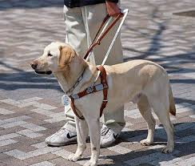
SERVICE ANIMALS

Slide 7
SERVICE ANIMAL REQUIREMENT
7
2.6 Service Animals Requirement
“The entity shall permit service animals to accompany individuals with disabilities in vehicles and facilities” (§ 37.167(d)).

Slide 8
Service Animal Definition
8
Per the ADA, a Service Animal is:
Any guide dog, signal dog, or other animal individually trained to work or perform tasks for an individual with a disability, including, but not limited to,
guiding individuals with impaired vision
alerting individuals with impaired hearing to intruders or sounds
providing minimal protection or rescue work
pulling a wheelchair
fetching dropped items

Slide 9
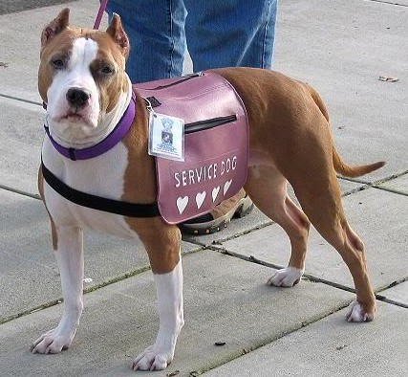
Service Animal Definition
9
QUESTION:
Must service animals be dogs?

Slide 10
Service Animal Definition
10
ANSWER: No
ADA: Any guide dog, signal dog, or other animal individually trained to work or perform tasks for an individual with a disability, including, but not limited to, guiding individuals with impaired vision, alerting individuals with impaired hearing to intruders or sounds, providing minimal protection or rescue work, pulling a wheelchair, or fetching dropped items.
Examples of other service animals?

Slide 11
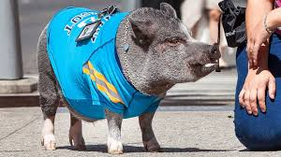
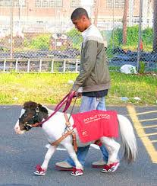
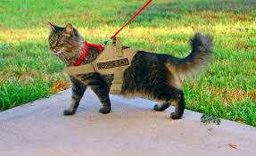
Variety of Service Animals
11

Slide 12
Service AnimalS
12

Slide 13
Service DOGS
13
QUESTION:
Can a service dog be any breed of dog? Even a pit bull?

Slide 14
Service DOGS
14
ANSWER: Yes
Any breed of dog can be a service animal; even a pit bull

Slide 15
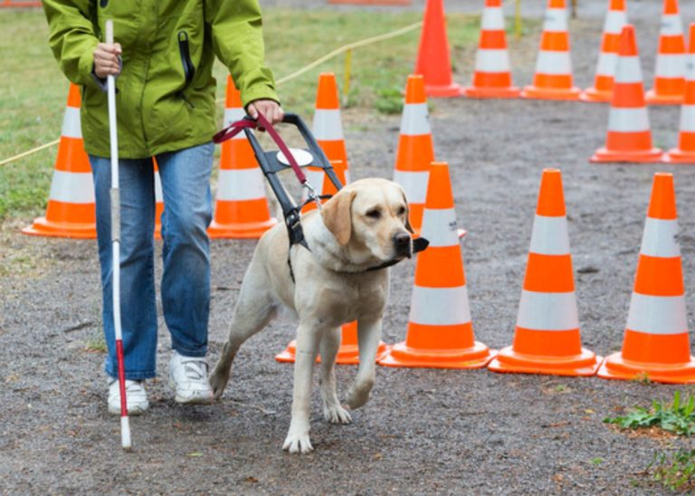
Service Animal Definition
15
QUESTION:
What characteristic must an animal possess in order to be considered a service animal?

Slide 16
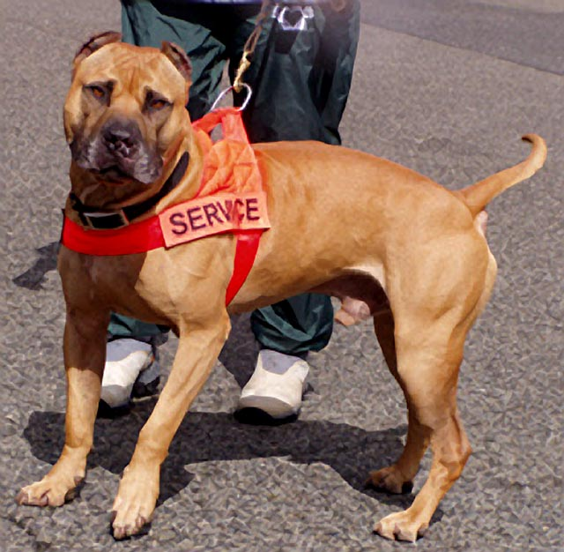
Service Animal Definition
16
ANSWER: The animal must be trainable.
ADA: Any guide dog, signal dog, or other animal individually trained to work or perform tasks for an individual with a disability, including, but not limited to, guiding individuals with impaired vision, alerting individuals with impaired hearing to intruders or sounds, providing minimal protection or rescue work, pulling a wheelchair, or fetching dropped items.

Slide 17
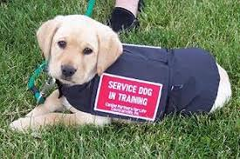
Service Animal Definition
17
QUESTION:
Must the service animal be professionally trained?

Slide 18
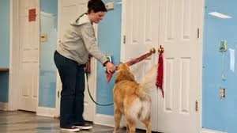
Service Animal Definition
18
ANSWER: No
People with disabilities have the right to train their own service animals

Slide 19
Service Animal Definition
19
Service Animals must perform tasks that assist people with disabilities.
ADA: Any guide dog, signal dog, or other animal individually trained to work or perform tasks for an individual with a disability, including, but not limited to,
guiding individuals with impaired vision
alerting individuals with impaired hearing to intruders or sounds
providing minimal protection or rescue work
pulling a wheelchair, or fetching dropped items.

Slide 20
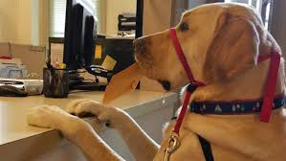
Service Animal Definition
20
QUESTION:
What other tasks can a Service Animal perform for a person with a disability?

Slide 21
Service Animal Definition
21
ANSWER:
If specifically trained as a psychiatric support animal, it is a service animal
Notify owner of oncoming seizure or notify others that a seizure has occurred
Remind owner to take medication
“Handing” pass to Operator

Slide 22
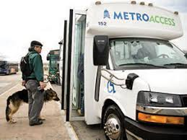
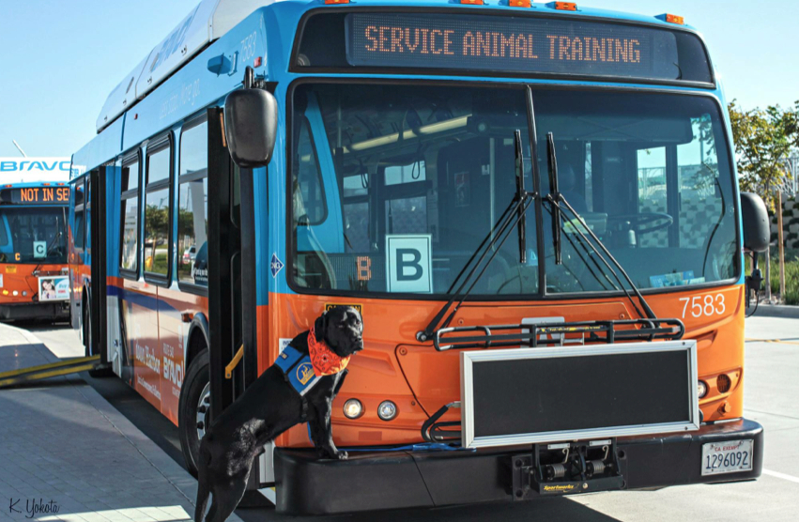
Service Animal Definition
22
QUESTION:
Must assistance provided be related to using public transportation?

Slide 23
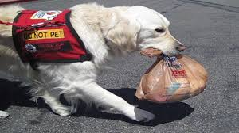
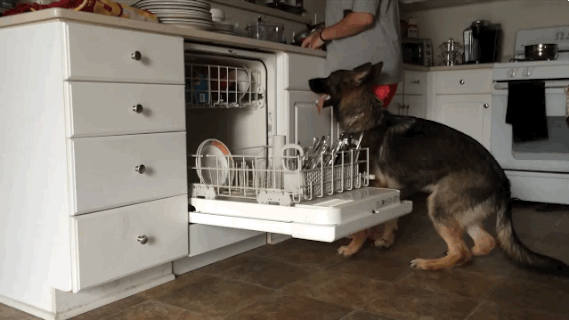
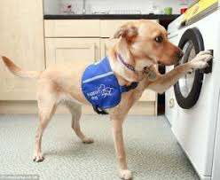
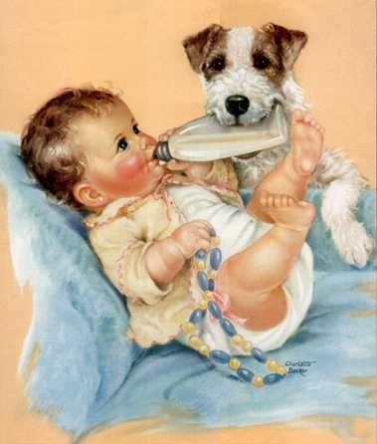
SERVICE ANIMAL DEFINITION
ANSWER: No
Assistance provided may be related to the person’s needs at home, work, shopping, etc.

Slide 24
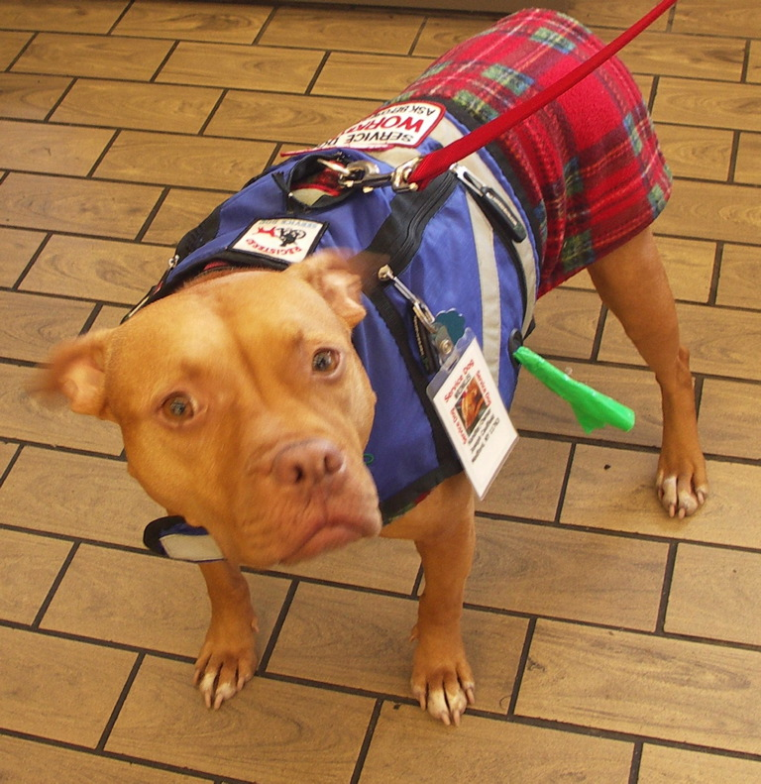
RECOGNIZING A Service Animal
24
QUESTION:
Is the presence of a harness, vest, patch, or backpack an indication of a service animal?

Slide 25
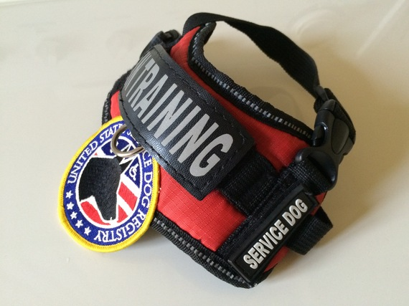
RECOGNIZING A SERVICE ANIMAL
25
ANSWER: No.
Service animals do not need to be certified, wear a vest, harness, etc.

Slide 26
RECOGNIZING A SERVICE ANIMAL
26
QUESTION:
How does an Operator determine if an animal is a service animal?

Slide 27
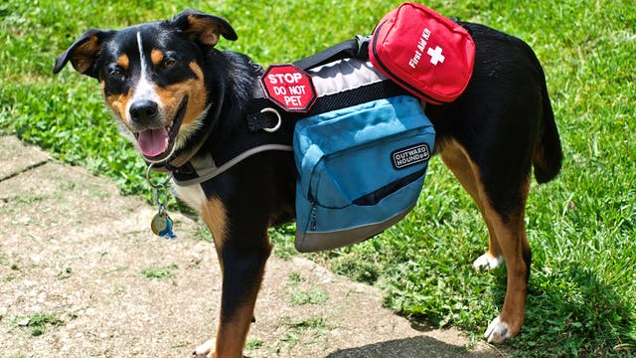
RECOGNIZING A SERVICE ANIMAL
27
ANSWER:
Is your animal a service animal required because of a disability?
What task/s has your animal been trained to perform?

Slide 28
CHALLENGES OF QUESTIONING
28
Are Operators proficient in determining whether responses are acceptable?
Penalties for improper denial of service include
Customer Complaints
Board Meeting Comments
Lawsuits
FTA Complaints
Enhanced Review Module (FTA ERM)

Slide 29
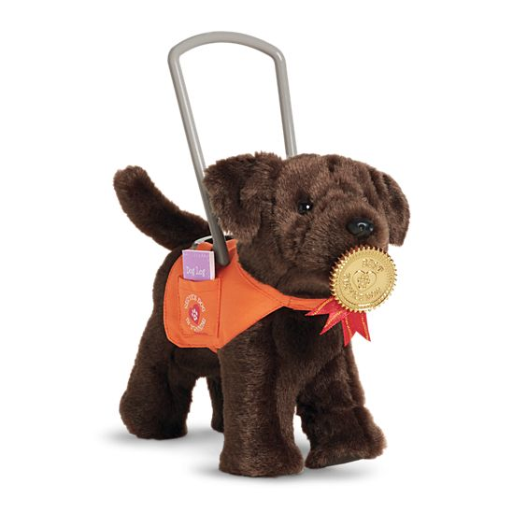
“CONTROL” OF SERVICE ANIMALS
29
Customers must have “control” of their service animals at all times
QUESTION:
Must a leash be used at all times? Why or why not?

Slide 30
POLL #1
30
QUESTION:
In order to consider an animal in “control”, it must be on a leash
FALSE

Slide 31
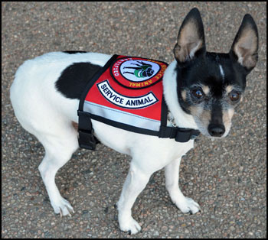
“CONTROL” OF SERVICE ANIMALS
31
ANSWER: No
A leash is not required if it prevents the service animal from completing task/s

Slide 32
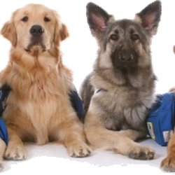
# OF SERVICE ANIMALS
32
QUESTION:
How many service animals can a person with a disability have?

Slide 33
POLL #2
33
QUESTION:
How many Service Animals can a rider have in transit?
As many as is needed due to their disabilities

Slide 34
# OF SERVICE ANIMALS
34
ANSWER: No limit; may have more than 1 service animal
It is possible that different animals provide different types of support

Slide 35
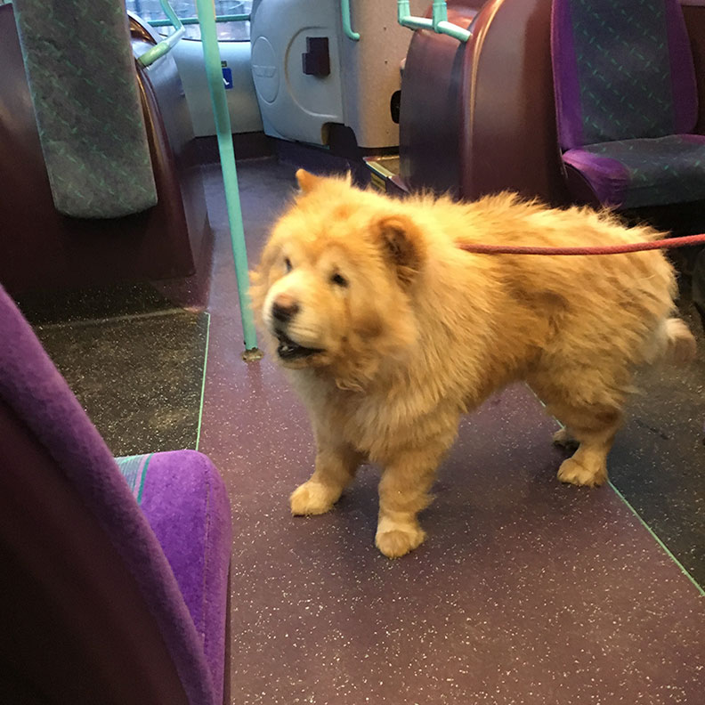
CARE OF A SERVICE ANIMAL
35
Who is responsible for the care and supervision of a service animal?
The Service Animal owner is responsible for care.
Can an Operator take possession of a service animal?
Yes, but…

Slide 36
DISRUPTIVE SERVICE ANIMALS
36
QUESTION: What can be done if a service animal is being disruptive?
Considerations:
Is the dog barking?
Is the animal off it’s leash?
Has the dog bitten someone?
Operator fear from past conduct

Slide 37
DIRECT THREAT
37
ANSWER: Yes
Direct Threat to the health and safety of the Operator or customers
Create seriously disruptive atmosphere
Not under control of their owner

Slide 38
DENYING SERVICE
38
“Concerns” that animals spread COVID-19
Even if true, objective evidence is needed proving that the animal has COVID-19
Rider statement may be sufficient if it can be substantiated
Negative test result may be required before using service

Slide 39
ALLERGIES
QUESTION:
Are animal allergies by the Operator or customers grounds for denying service to a customer with a Service Animal?

Slide 40
ALLERGIES
ANSWER: No
Per the ADA, allergies to animals are not grounds for denying service to a customer using a service animal
Encountering a service animal in transit or other environment is an expected part of being in public

Slide 41
SERVICE ANIMALS and toileting
41
QUESTION: If a service animal is on your vehicle and it needs “toileting”, what should the Operator do?

Slide 42
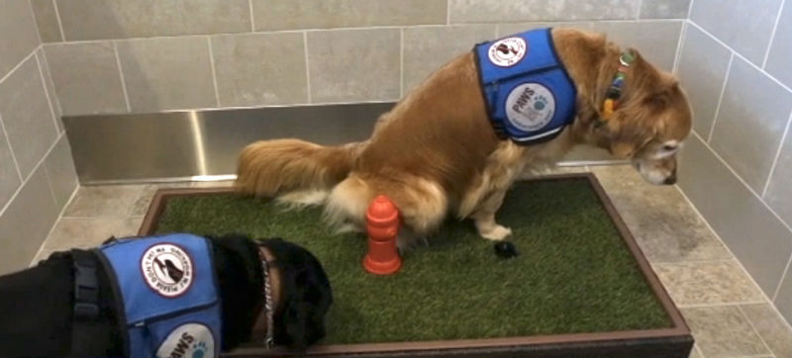
SERVICE ANIMALS and toileting
42
ANSWER:
Per the ADA, Bus Operators are not required to hold the vehicle while a service animal is “toileting”
Paratransit Operators should check with dispatch
No-Stranding Policy

Slide 43
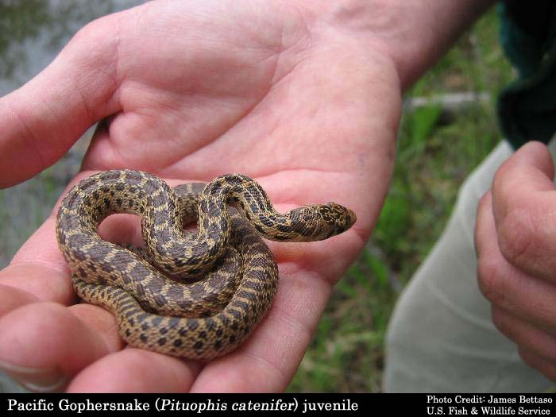
NOT A SERVICE ANIMAL
43
Pets
Emotional Support animals
Therapy animals
Comfort animals
Companion animals

Slide 44
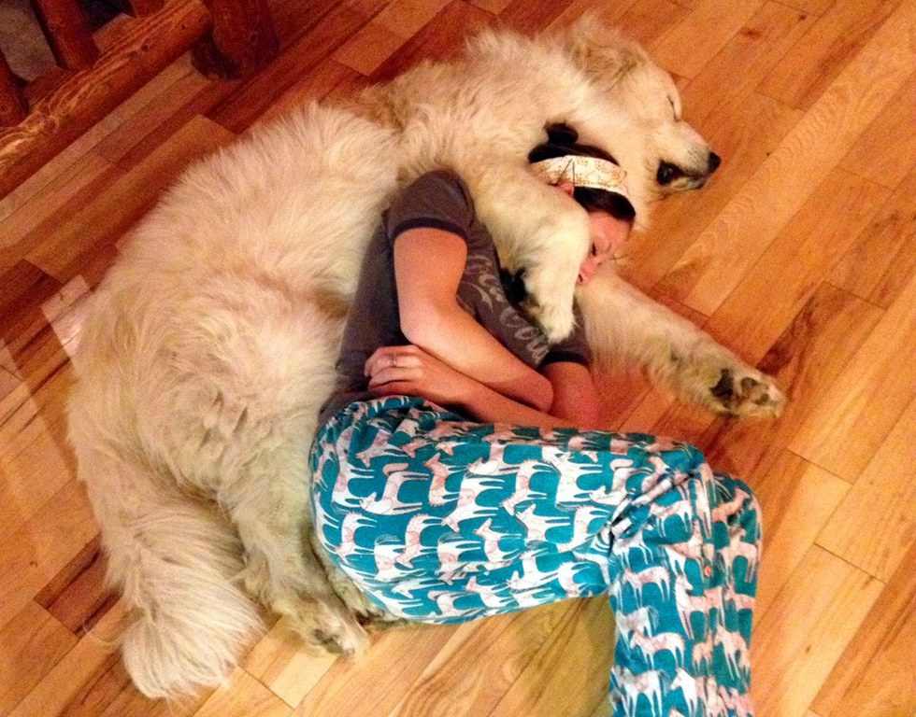
EMOTIONAL SUPPORT ANIMAL
44
Emotional support provided by an animal is done so passively, by nature, or through the perception of the owner
Animals are not trained to provide comfort and support.
An agency can have policies to allow comfort animals to use public transit, however

Slide 45
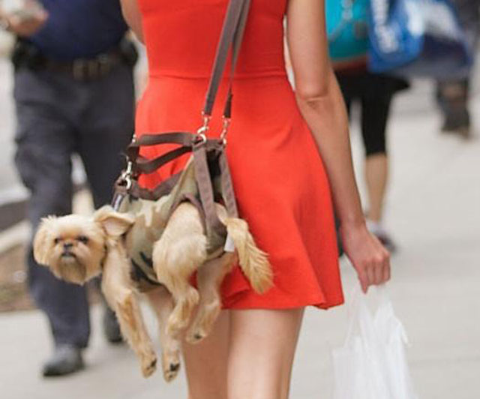
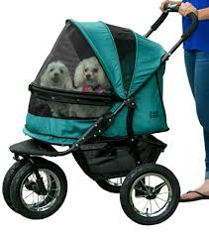
PET CARRIERS
45
Are these carriers acceptable for transporting a pet?

Slide 46
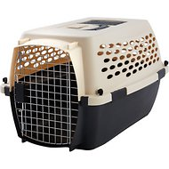
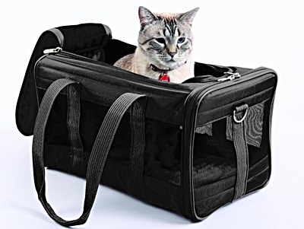
PET CARRIERS
46
Are these carriers acceptable for transporting a pet?

Slide 47
PET CARRIERS POLICY CONSIDERATIONS
47
Carriers should be closed
Must not block the doorways or aisles if placed on the floor
Should not be placed on seats; this reduces the available seating on a vehicle

Slide 48
SERVICE ANIMAL POLICIES
BEST PRACTICES
Strictly following the regulations or customizing to your “culture of accessibility)
Consider the “worst case scenarios” and how your agency will handle them; (i.e. emotional support animals)
Do your Operators get in arguments when asking riders about their animals?
Make sure your policy is very specific regarding what an out of control Service Animal is (barking incessantly, lunging at riders, roaming the vehicle uncontrolled, has bitten a rider, is stronger than their handler, etc.”

Slide 49
Boulder, co complaint
Customer boarded vehicle with a snake
Another customer filed a complaint regarding a snake being onboard
Customer with snake stated that he trained the snake to notify him of oncoming seizures
Customer was allowed to ride; compliant with the ADA
Complaining customer was not happy with decision

Slide 50
Questions?
Policy Clarification?
Additional Best Practices?
Comments on Service Animal issue?

Slide 51
THANK YOU!
Jess Segovia, ADA Guru
Your ADA Compliance Expert
www.ADAguru.co
info@ADAguru.co
Direct 626.379.8400

Slide 52
ADA Reasonable Modifications Made Simple

Slide 53
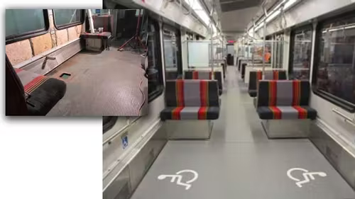
You can’t legislate common sense. Or can you?
ADA Reasonable Modifications are intended to be simple actions that transit, or paratransit providers can take that enable people with disabilities to more easily use public transportation.

Slide 54
Presentation Overview
The Requirement
Exceptions
Examples – What is and what is not a Reasonable Modification
Procedural Requirements
Tips and Tricks from Real-Life
Questions, Comments and Discussion

Slide 55
Definition of an ADA Reasonable Modification
Public transportation entities providing fixed-route transit, demand-response and ADA paratransit services are required to make reasonable modifications/accommodations to their policies, practices, and procedures to ensure program accessibility for people with disabilities.

Slide 56
Exceptions:
When the requested modification is not necessary for the individual to utilize service.
When the modification would fundamentally alter the nature of the service being provided.
When the modification would pose a “direct threat” to the health or safety of others.
When the modification would pose an undue administrative or financial burden on the agency.

Slide 57
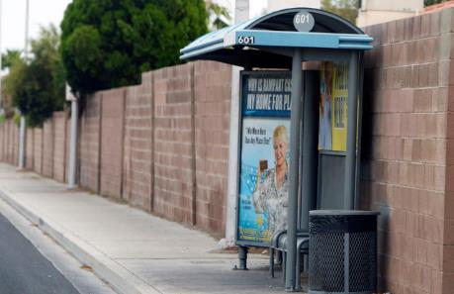
Example #1 – What are and what are not Reasonable Modifications
The bus stop is not accessible for my wheelchair, but there’s a driveway right next to the stop. I need the driver to stop there.
Is this a Reasonable Modification?
Why or why not?

Slide 58
Example #2 – What are and what are not Reasonable Modifications
My trip to work is over 90 minutes long, and I need to eat a snack on the way, or I risk a diabetic reaction. The drivers keep telling me that there’s no eating on the bus. Can you make an exception?
Is this a Reasonable Modification?
Why or why not?

Slide 59
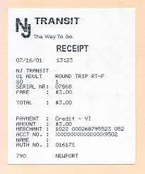
Example #3 – What are and what are not Reasonable Modifications
The Department of Rehabilitation reimburses me for my use of paratransit, but they need receipts. I need the driver for each trip to write me a receipt with the date, time, pick-up and drop-off addresses and the amount I paid so I can document my use of paratransit and get reimbursed for my out-of-pocket expenses.
Is this a reasonable modification?
Why or why not?

Slide 60
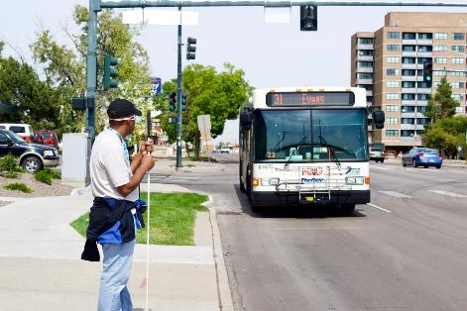
Example #4 – What are and what are not Reasonable Modifications
My house is right on the bus route, but I’m three blocks from the nearest stop, and there’s a dangerous street crossing between my house and the stop. I need the driver to stop in front of my house so I can take the bus to and from work.
Is this a reasonable modification?
Why or why not?

Slide 61
Example #5 – What are and what are not Reasonable Modifications
The big paratransit minibuses are old, and the rides are bumpy. I have a back condition that makes it incredibly painful to ride them for more than a few minutes. I know, for a fact, that you guys use cabs when the vans are full. I want you to assign all of my trips to cabs from now on.
Is this a reasonable modification?
Why or why not?

Slide 62
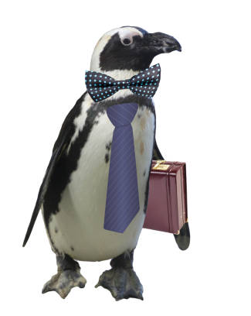
Example #6 – What are and what are not Reasonable Modifications
Your policy permits service animals, but not emotional support animals. I have an emotional support animal to help me feel calm. Without my emotional support penguin, I simply can’t leave home. Please make an exception. He’s very well-behaved. And he will be the best-dressed bird on transit.
Is this a reasonable modification?
Why or why not?

Slide 63
Example #7 – What are and what are not Reasonable Modifications
It’s hard for me to get out and go, so I combine all my shopping into a single trip each month. I need you guys to waive your grocery bag policy because not only do I need to carry food for the month. A skunk is getting into my garden and stealing the food I’m growing. I need these cinder blocks to tighten up the perimeter fence so I can keep him out and have nice radishes for my salads this fall.
Is this a reasonable modification?
Why or why not?

Slide 64
Procedural Requirements
Transit agencies can establish their own RM policies and administrative procedures but are subject to review by the USDOT.
Information about the RM policy and procedures must be available and accessible for people with disabilities.
The RM policy must clearly spell out the process by which individuals with disabilities can request RMs.
The policy should permit RM requests to be made in advance or at the point when the customer needs the modification.
If the agency denies the customer’s request, the agency should provide an explanation for the denial, and if possible, the agency should consider potential work-arounds that address the customer’s need.

Slide 65
Tips and Tricks
Create a policy and procedures that address:
Definition and limitations to RMs
Examples of what are and are not RMs
Procedures for requesting RMs in advance and at the time they are needed
Procedures and timelines that agency will use for receiving, evaluating and deciding on RM requests.
Procedures (if any) for appealing an adverse decision
Work with appropriate personnel (including frontline personnel) to determine what RM requests can be granted on-the-spot and which need to be evaluated before a decision is made.
Provide frontline training about RMs and include specific examples of the types of decisions that frontline staff is able to make.
Use safety meetings to survey drivers and dispatchers on the types of on-the-spot RMs they are handling so that all can handle them consistently.
Conduct RM training with your agency’s accessibility advisory committee and other community stakeholders so they understand the requirements and their intended purpose.

Slide 66
Helpful Resources
USDOT’s Final Rule: “Transportation for Individuals With Disabilities; Reasonable Modification”
https://www.federalregister.gov/documents/2015/03/13/2015-05646/transportation-for-individuals-with-disabilities-reasonable-modification-of-policies-and-practices
Sample RM Policies
WestCAT – Pinole, CA
https://www.westcat.org/home/RiderADA
Simple policy with clear instructions for requesting RMs
Provides a timeline for answering a RM request.
Includes complaint procedures for people who disagree with the agency’s decision.

Slide 67
Helpful Resources
StanRTA – Modesto, CA
https://www.stanrta.org/400/Reasonable-Modifications-Policy
Clear definition and explanation of limitations.
Identifies a couple of examples of RMs that can be approved on the spot.
Simple method for requesting a RM by phone.
North County Transit District – Oceanside, CA
https://gonctd.com/accessibility/reasonable-modification-policy/
Clear definition of a RM and limitations
Clear explanation of the process for making a request

Slide 68
Helpful Resources
Valley Metro - Phoenix, AZ
https://www.valleymetro.org/accessibility/requesting-reasonable-modifications
Identifies the official agency point of contact
Detailed definition of what does, and does not, constitute a RM.
Lists methods for requesting a RM
Outlines the process and timelines for making decisions
Incorporates the ADA appeals process for anyone who disagrees with VM’s decision.
Administers RM process for other area transit agencies.

Slide 69
Questions, Comments, Discussion

Slide 70
Ron Brooks, Founder and CEO Accessible Avenue, LLC (602) 616-1171 www.AccessibleAvenue.net

Slide 71
ACCESSIBILITY TRIVIA

Slide 72
QUIZ – QUESTION #1
ANY POLICY OR PRACTICE THAT PREVENTS AN INDIVIDUAL WITH A DISABILITY FROM USING VIA’s SERVICES IS CONSIDERED A (select all that apply):
Bad day riding the bus; these things happen
Barrier to accessibility
A harmless mistake by VIA and/or the Operator
Violation of a customer’s civil rights
Notes:
Question one any policy or practice that prevents an individual with a disability from using Villa services Inc. is considered a:

Slide 73
ANSWER – QUESTION #1
ANY POLICY OR PRACTICE THAT PREVENTS AN INDIVIDUAL WITH A DISABILITY FROM USING VIA’s SERVICES IS CONSIDERED A (select all that apply):
Bad day riding the bus; these things happen
Barrier to accessibility
A harmless mistake by VIA and/or the Operator
Violation of a customer’s civil rights

Slide 74
QUIZ – QUESTION #2
WHICH OF THE FOLLOWING ARE REQUIREMENTS OF ALL VIA OPERATORS (select all that apply):
Are trained to proficiency, experts in their job
Operate vehicles and equipment safely
Take possession of a Service Animal if asked
Treat all customers in a respectful and courteous way

Slide 75
ANSWER – QUESTION #2
WHICH OF THE FOLLOWING ARE REQUIREMENTS OF ALL VIA OPERATORS (select all that apply):
Are trained to proficiency, experts in their job
Operate vehicles and equipment safely
Take possession of a Service Animal if asked
Treat all customers in a respectful and courteous way

Slide 76
QUIZ – QUESTION #3
IF THE AUTOMATED VOICE ANNOUNCEMENT (AVA) SYSTEM MALFUNCTIONS, OPERATORS MUST (select all that apply):
Announce stops only if a customer with a disability is onboard
Announce stops at all major intersections, transfer points, requested stops and route changes
Make announcements in a clear, distinct voice

Slide 77
ANSWER – QUESTION #3
IF THE AUTOMATED VOICE ANNOUNCEMENT (AVA) SYSTEM MALFUNCTIONS, OPERATORS MUST (select all that apply):
Announce stops only if a customer with a disability is onboard
Announce stops at all major intersections, transfer points, requested stops and route changes
Make announcements in a clear, distinct voice

Slide 78
QUIZ – QUESTION #4
WHEN SHOULD SECUREMENT EQUIPMENT BE TESTED TO ENSURE THAT THEY ARE FUNCTIONING PROPERLY?
Maintenance staff checks all equipment, not Operators
customer
During Pre Pull Out process
Equipment is not checked regularly
Notes:
Question one any policy or practice that prevents an individual with a disability from using Villa services Inc. is considered a:

Slide 79
ANSWER – QUESTION #4
WHEN SHOULD SECUREMENT EQUIPMENT BE TESTED TO ENSURE THAT THEY ARE FUNCTIONING PROPERLY?
Maintenance staff checks all equipment, not Operators
During Pre Pull Out process
Equipment is not checked regularly
Notes:
Question one any policy or practice that prevents an individual with a disability from using Villa services Inc. is considered a:

Slide 80
QUIZ – QUESTION #5
WHEN CAN A CUSTOMER USING A WHEELCHAIR BE REQUIRED TO TRANSFER TO A SEAT?
Anytime the Operator thinks it is appropriate
When the Operator has difficulty securing the wheelchair
The Operator can never require a transfer

Slide 81
ANSWER – QUESTION #5
WHEN CAN A CUSTOMER USING A WHEELCHAIR BE REQUIRED TO TRANSFER TO A SEAT?
Anytime the Operator thinks it is appropriate
When the Operator has difficulty securing the wheelchair
The Operator can never require a transfer

Slide 82
QUIZ – QUESTION #6
WHAT WHEELCHAIR COMPONENTS SHOULD BE AVOIDED DURING SECUREMENT (select all that apply):
Removable parts such as the foot and arm rests
Hydraulics and wires
All wheelchair components can be used for securement

Slide 83
ANSWER – QUESTION #6
WHAT WHEELCHAIR COMPONENTS SHOULD BE AVOIDED DURING SECUREMENT (select all that apply):
Removable parts such as the foot and arm rests
Hydraulics and wires
All wheelchair components can be used for securement

Slide 84
QUIZ – QUESTION #7
WHAT STEPS SHOULD BE FOLLOWED WHEN CONSIDERING TO DENY SERVICES DUE TO BODILY FLUIDS (select all that apply):
Confirm visual evidence of any fluids
Contact Dispatcher for assistance
Be respectful of the customer at all times
Notes:
Question one any policy or practice that prevents an individual with a disability from using Villa services Inc. is considered a:

Slide 85
ANSWER – QUESTION #7
WHAT STEPS SHOULD BE FOLLOWED WHEN CONSIDERING TO DENY SERVICES DUE TO BODY FLUIDS (select all that apply):
Confirm visual evidence of any fluids
Contact Dispatcher for assistance
Be respectful of the customer at all times
All are correct.
Notes:
All of the answers are correct.

Slide 86
QUIZ – QUESTION #8
IF A CUSTOMER IS BEING DENIED SERVICE, THEY MAY (select all that apply):
Contest the decision
Ignore the Operator
Fix the issue in question and resume service

Slide 87
ANSWER – QUESTION #8
IF A CUSTOMER IS BEING DENIED SERVICE, THEY MAY (select all that apply):
Contest the decision
Ignore the Operator
Fix the issue in question and resume service

Slide 88
QUIZ – QUESTION #9
TRUE OR FALSE
AN OPERATOR CAN DENY SERVICES TO A CUSTOMER WITH A DISAIBLITY THAT REQUIRES ADDITIONAL TIME TO BOARD UNTIL THEY BEGIN USING A WHEELCHAIR OR SCOOTER IN ORDER TO SPEED THEIR BOARDING.

Slide 89
ANSWER – QUESTION #9
FALSE
AN OPERATOR CAN DENY SERVICES TO A CUSTOMER WITH A DISAIBLITY THAT REQUIRES ADDITIONAL TIME TO BOARD UNTIL THEY BEGIN USING A WHEELCHAIR OR SCOOTER IN ORDER TO SPEED THEIR BOARDING.
Notes:
Operators may not deny service and require use of a wheelchair. It is up to the customer to determine what, if any, mobility device they can use to assist them with their mobility. Including not using a device at all..

Slide 90
QUIZ – QUESTION #10
TRUE OR FALSE
IT IS CONSIDERED A REASONABLE LEVEL OF ASSISTANCE TO LIFT A CUSTOMER OUT OF THEIR WHEELCHAIR.
Notes:
Question one any policy or practice that prevents an individual with a disability from using Villa services Inc. is considered a:

Slide 91
ANSWER – QUESTION #10
FALSE
IT IS CONSIDERED A REASONABLE LEVEL OF ASSISTANCE TO LIFT A CUSTOMER OUT OF THEIR WHEELCHAIR.
Notes:
CARRYING A CUSTOMER WITH A DISABILITY IS NOT A REASONABLE LEVEL OF ASSISTANCE. THIS IS UNSAFE FOR THE OPERATOR AND THEY ARE NOT TRAINED TO PROVIDE SUCH ASSISTANCE.

Slide 92
QUIZ – QUESTION #11
TRUE OR FALSE
IT IS UNREASONABLE FOR AN OPERATOR TO REQUIRE THE CUSTOMER TO SHARE THE NATURE OF THEIR DISABILITY IN ORDER TO RECEIVE SERVICE.
Notes:
Question one any policy or practice that prevents an individual with a disability from using Villa services Inc. is considered a:

Slide 93
ANSWER – QUESTION #11
TRUE
IT IS UNREASONABLE FOR AN OPERATOR TO REQUIRE THE CUSTOMER TO SHARE THE NATURE OF THEIR DISABILITY IN ORDER TO RECEIVE SERVICE.
Notes:
Question one any policy or practice that prevents an individual with a disability from using Villa services Inc. is considered a:

Slide 94
QUIZ – QUESTION #12
A CUSTOMER WITH A DISABILITY REQUESTS THAT THE BUS BE HELD FOR SEVERAL MINUTES WHILE THEY BUY A SODA NEARBY. THE OPERATOR SHOULD…(select all that apply):
Wait for the customer patiently
Deny the request and inform the customer that they are unable to hold the bus
Inform the customer that the next bus is X minutes behind

Slide 95
ANSWER – QUESTION #12
A CUSTOMER WITH A DISABILITY REQUESTS THAT THE BUS BE HELD FOR SEVERAL MINUTES WHILE THEY BUY A SODA NEARBY. THE OPERATOR SHOULD…(select all that apply):
Wait for the customer patiently
Deny the request and inform the customer that they are unable to hold the bus
Inform the customer that the next bus is X minutes behind

