Slide 1
Operator Recruitment and Village Vans Program Emily Bergkamp Director of Operations

Slide 2
Overview
Intercity Transit
How Transit Found Me
Operator Recruitment
About Village Vans
Stats Review
Community Partners
Meet Grant and Izi
Passenger Success

Slide 3
Intercity Transit
Olympia, Washington
State Government
Colleges
Public Transportation Benefit Area
Serving Thurston County Since 1981
Population 180,000
Approximately 100 square mile service area
86 Coaches (Fixed Route), 54 Cutaways (ADA Paratransit)
Zero Fare Pilot through 2028
Notes:
2021 Avg. Weekday Fixed Route trips: 7,078 down 46% from 2019 (13,089)
2021 Annual ADA trips: 113,898 down 46% from 2019 (209,227 )

Slide 4
How Transit Found Me
Non-Profit Work
Seniors
People with Disabilities
Community Volunteerism
Transit Advisory Committee
Public Transit Professionals
Transit as a Career
Mostly in Operations
Some in Development
Notes:
Vanpool Coordinator 2004
Youth Education Specialist in 2007
Dial-A-Lift Manager in 2008
Operations Director in 2018

Slide 5
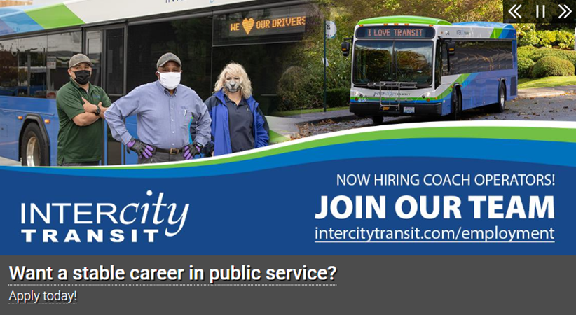
Operator Recruitment
Method
Hire for Customer Service Skills
Negotiated higher increase to base wages
Focus on transit as a career with state benefits package and deferred comp/401k options
Notes:
Craigslist
Indeed
Twitter
Facebook
WorkSource: WorkSource is a statewide partnership of state, local and nonprofit agencies that provides an array of employment and training services to job seekers and employers in Washington.
Thurston County Chamber Hot Jobs List
Pacific Mountain Workforce Development Council: The Pacific Mountain WorkForce Development Council (PACMTN) is a nonprofit organization dedicated to the development of a workforce system that supports business, industry, and all levels of employers and job seekers.
Capital Mall social media package
Joint Base Lewis McChord
Commercial Driver School
Sandwich boards at Transit Centers
Headway signs
Recruitment software puts the position on a few platforms
Government Jobs
Hire G.I.
Starting competitive wage is $22.21

Slide 6
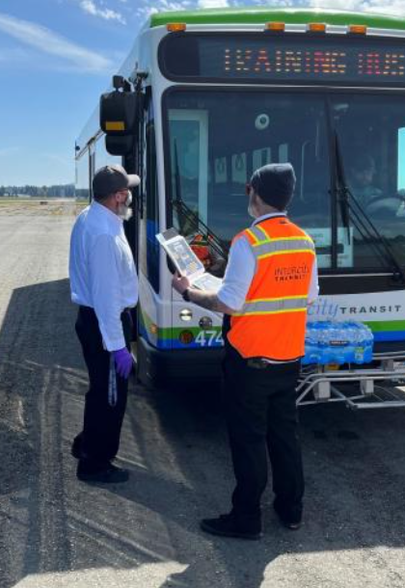
Operator Recruitment
Operator Training Timeline
Contingent job offers
Offer temporary jobs as interim option
8-week training cycle
Fast track CDL holders
Notes:
2019 hired 81 Coach Operators
2020 hired 20 Coach Operators
2021 hired 39 Coach Operators

Slide 7
Village Vans A Workforce Development Program
Passenger
Employment Related Transportation
Reduce transportation barriers so that passengers can become financially independent
Volunteer
Driving passengers, dispatching and job shadowing
Assist with cover letters, resumes and mock/informative interviews
Connections within the community
Develop work skills for participants so they are competitive in the job market
Notes:
Intercity Transit’s Village Vans program, in Operation since 2002, has been awarded multiple federal competitive funds for both Operating and Capital expenses. Operating funds were used to fund 50% of the staff time used to administer the program. Capital funds were used to purchase 50% (or 2 out of 4) of the vans used for the program. The Village Vans program was 1 of 16 agencies awarded an Innovative Transit Workforce Development grant in FY2015. Total federal grant funding secured has totaled nearly $1 million dollars.

Slide 8
Poverty Competency
Beegle Poverty Immersion Institute (Portland, OR)
2-day course gaining knowledge and education
Understanding of poverty and what we can do to successfully assist people in moving out – and staying out – of poverty.
https://www.combarriers.com/povertyinstitute

Slide 9
Village Vans Volunteer Stats
Employment Hires:
2019: 21
2020: 19
2021: 7
Employment with Intercity Transit:
2019: 11
2020: 4
2021: 4
Employment in Transportation Field:
2019: 16
2020: 2
2021: 2
Notes:
2019: out of 81 total Coach Operator Hires = 14%
2020: out of 20 total Coach Operator Hires = 20%
2021: out of 39 total Coach Operator Hires = 10%
25 Village Vans volunteers are still employed at Intercity Transit, 22 of which are Operators. Just under 10% of our Operator workforce. Share during questions, if asked.
Volunteers:
2019: 33
2020: 18
2021: 7
Volunteer Hours:
2019: 4,505
2020: 1,225
2021: 2,009

Slide 10
Village Vans Volunteer Stats
Employment Hires:
2019: 21
2020: 19
2021: 7
Employment with Intercity Transit:
2019: 11
2020: 4
2021: 4
Employment in Transportation Field:
2019: 16
2020: 2
2021: 2
Intercity Transit has hired 33 Village Vans Volunteers since 2002. 25 of these volunteers still work at I.T., including 22 Operators.
Notes:
2019: out of 81 total Coach Operator Hires = 14%
2020: out of 20 total Coach Operator Hires = 20%
2021: out of 39 total Coach Operator Hires = 10%
25 Village Vans volunteers are still employed at Intercity Transit, 22 of which are Operators. Just under 10% of our Operator workforce. Share during questions, if asked.
Volunteers:
2019: 33
2020: 18
2021: 7
Volunteer Hours:
2019: 4,505
2020: 1,225
2021: 2,009

Slide 11
Village Vans Passenger Trips
2019 Trips
Work Support: 3,708
Daycare Stops: 1,640
School or Training: 952
2020 Trips
Work Support: 1,892
Daycare Stops: 1,378
School or Training: 450
2021 Trips
Work Support: 1,292
Daycare Stops: 128
School or Training: 226
Notes:
Revenue miles:
2019: 35,702
2020: 22,290
2021: 14,990

Slide 12
Community Partnerships
WA Department of Social and Health Services
Division of Vocational Rehabilitation
Department of Child Support
Pacific Mountain Workforce Development Council
WorkSource
South Puget Sound Community College
Workforce Transitions Program
Work Study
Notes:
Community Partners directly support:
Coordinated online resource referrals
Ongoing coordination meetings
Scheduled resource fairs to educate client-based programs to ongoing resource development
One on one referrals to address access by clients and employers
Joint marketing and outreach crossing program boundaries
Direct referral and placements
Outreach and marketing of the Village Vans Program is ongoing. Outreach is targeted towards low-income community members seeking or sustaining new employment or those encountering transportation barriers related to employment. Outreach consists of career fairs, development and distribution of program materials, weekly and monthly meetings with strategic partners and recruitment interviews and referrals of potential new volunteers or participants. Ongoing website updates related to Program operation and services and through our strategic partners is part of the coordination and communications supporting the partnerships.

Slide 13
Volunteer Screening
Helpful during job fairs and hiring events

Slide 14
Volunteer to Operator then Dispatcher: Grant
Notes:
Before Grant became a Village Vans volunteer, he had gone through several life changes that had caused him to hit “rock bottom.” Life had become overwhelming following a recent divorce and less time with his children. He says he felt aimless and didn’t have a sense of what he should do next. Grant describes that these were pretty dark days. In 2016, when he was at a local coffee shop, he noticed a Village Vans pamphlet. He called the same day and was interviewed for a volunteer position the next day. He says he was truly unsure about working with people. In his previous work as a commissioned salesperson, he often gave too much of himself and got burnt out. But, he says the faith Village Vans staff had in him gave greatly contributed to the confidence to be where he is today. He volunteered for 6 months in Village Vans and interviewed for 2 non-Operator positions at Intercity Transit before interviewing for and being selected as an ADA Paratransit Operator. Grant has been an ADA Paratransit Operator with Intercity Transit for almost 6 years and served for nearly 2 years as an ADA Paratransit Dispatch Intern before being hired on in that position.

Slide 15
Volunteer to Operator then Dispatcher: Grant
Notes:
In his spare time, Grant enjoys all things trivia, comics, anime and has a love of the band The Posies, as shown by this awesome tattoo. He also has 2 shelter cats named Mistress Noodles and Mister Wayne. His greatest joy is traveling to California to visit his three children.

Slide 16
Volunteer to Operator then Supervisor: Izi
Notes:
Izi moved to Washington State from Wisconsin to attend The Evergreen State College and volunteered in the Village Vans program intermittently from 2017 to 2019. During that time, they also worked at Costco, a supported living service providing support to adults with Developmental Disabilities living in our communities and through work study at The Evergreen State College. Izi joined Intercity Transit in February of 2019 as a Coach Operator. During their time with us, Izi has served on the Operators Communication and Policy Committee, the Cut Commute Committee, and as a Core Trainer mentoring new Coach Operators with an emphasis on safety and service. In 2022, Izi was the successful candidate to fill the role of Village Vans Supervisor.

Slide 17
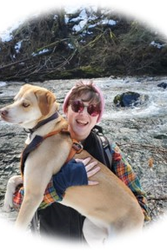
Volunteer to Operator then Supervisor: Izi
Notes:
Izi is a proud Evergreen State College aka “Greener” grad – go Geoducks! Izi enjoys reading literature of all types, being out in nature, and hiking with their partner Kayvin and fur baby Kubou. When asked about their interest in serving as the Village Vans program Supervisor, Izi shared “I know firsthand how this wonderful program changes lives for the better. My positivity and compassion will allow the program to keep providing vital services to our community.” Izi joined steadfast Village Vans Assistant Eric in the vital work of removing barriers to economic independence for our community members experiencing issues of poverty.

Slide 18
Passenger Success
Notes:
They were a survivor of domestic violence and had changed their identity to keep themselves safe. They used Village Vans for transportation making finding work and employment possible.
They are a single parent and full-time provider for their family. Village Vans helped them get to and from work faster.
They were a convicted felon living in rural Thurston county without a car or nearby access to transit. They became a Village Vans passenger so they could attend a local community college and earn their GED. Village Vans made their success possible by providing transportation to school. They commented, “with my diploma, I can do anything.”
“I saw a Village Vans poster and sensed this was something worth investigating. Little did I know that it would create so many opportunities. I really enjoy being part of a program that supports people in transition, finding stability in their lives. Volunteering lets me see the well-being of others that also enriches my own life.”
“At a time in my life when I was searching for clarity, I found tremendous assistance and answers in the Village Vans Program. I was able to assist others, determine my next move and secure employment. I will always be grateful for the opportunity and pleasure of working with such caring and helpful staff.”

Slide 19
My Name is Not “Those People”
The wind will stop before I let my children become a statistic.
Before you give in to the urge to blame me,
the blames that lets us go blind and unknowing into
the isolation that disconnects us, take another look.
Don’t go away.
For I am not the problem, but the solution.
And…My name is not “Those People.”
Excerpt from Julia Dinsmore’s poem, My Name Is Not “Those People,” included in her book, My Name Is Child of God … Not “Those People”: A First-Person Look at Poverty (Augsburg Fortress Publishers)

Slide 20
Thank you!
Emily Bergkamp, Director of Operations
ebergkamp@intercitytransit.com
360-705-5889

